Slide 1
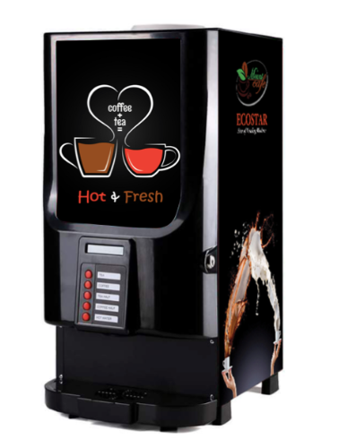
Drinks Vending Machine
System
By:
Jasmeet Singh Matta
Jaouaher Belgacem
Evrard Leuteu Feukeu

Slide 2

MOTIVATION

Slide 3
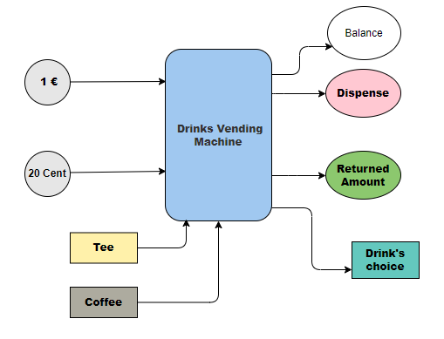
System’s Concept
Block Diagram

Slide 4
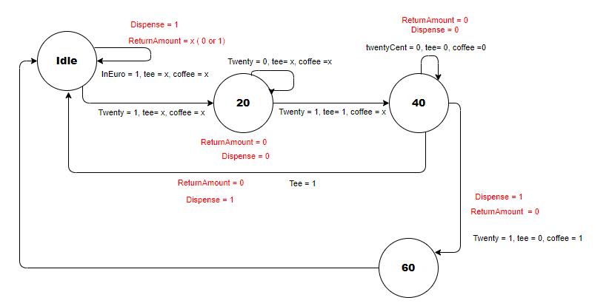
System’s Concept
FSM Diagram

Slide 5
VHDL Part
Three Processes’ Method:
State Memory Process
Next_State Process
Output Process

Slide 6
TestBench Part

Slide 7
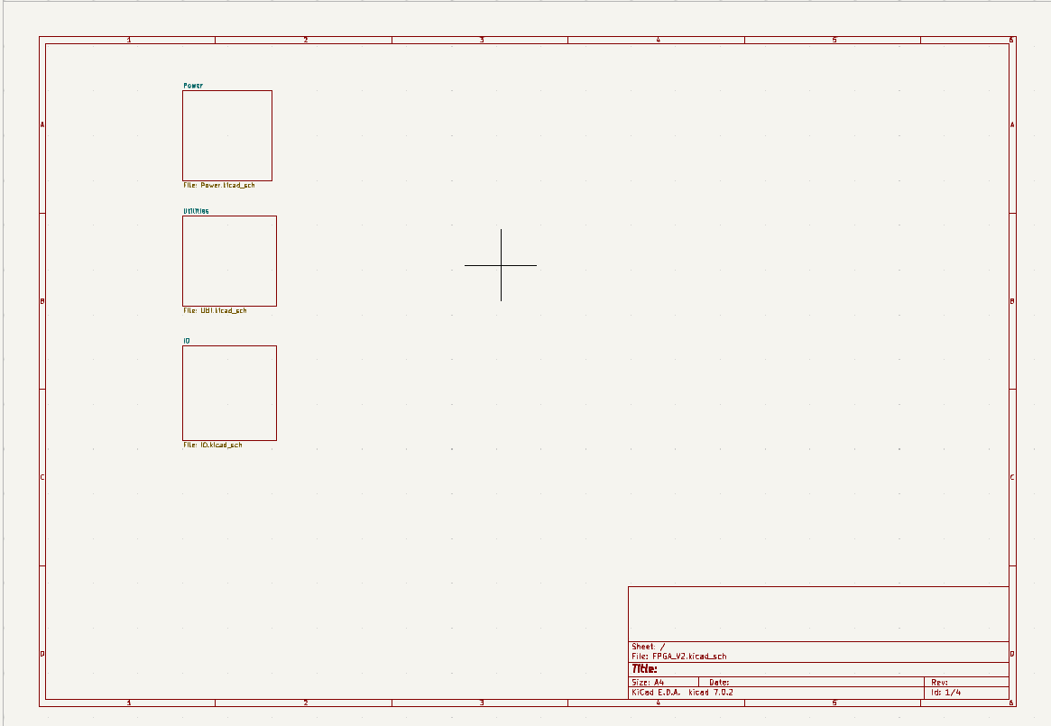
PCB Part
Schematic

Slide 8
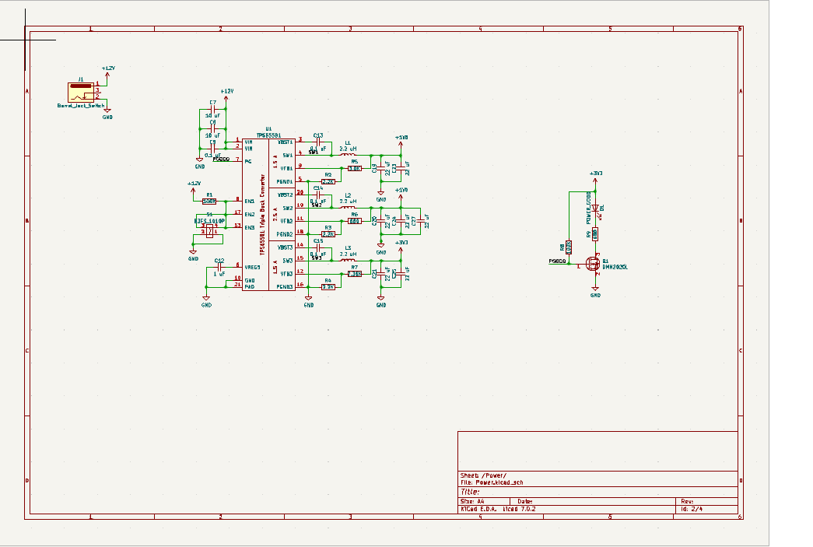
PCB Part
Schematic

Slide 9
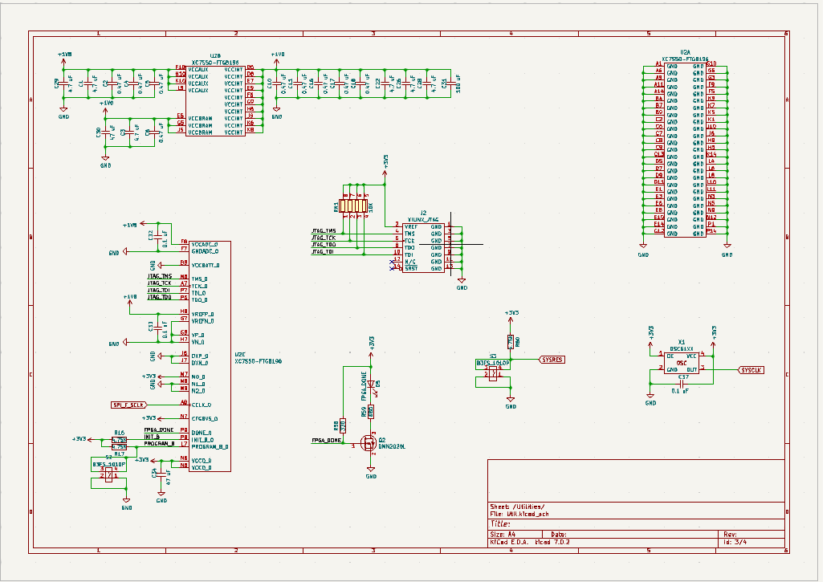
PCB Part
Schematic

Slide 10
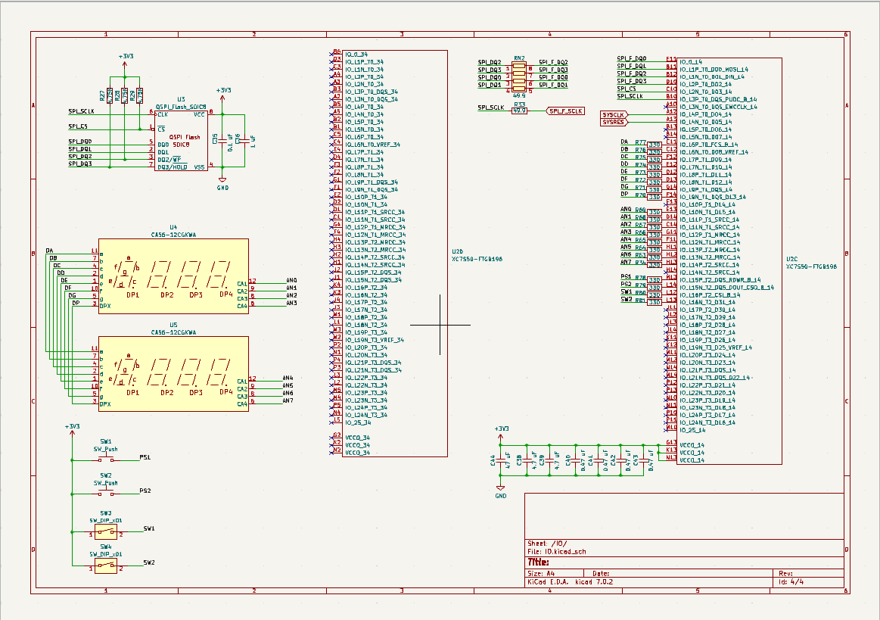
PCB Part
Schematic

Slide 11
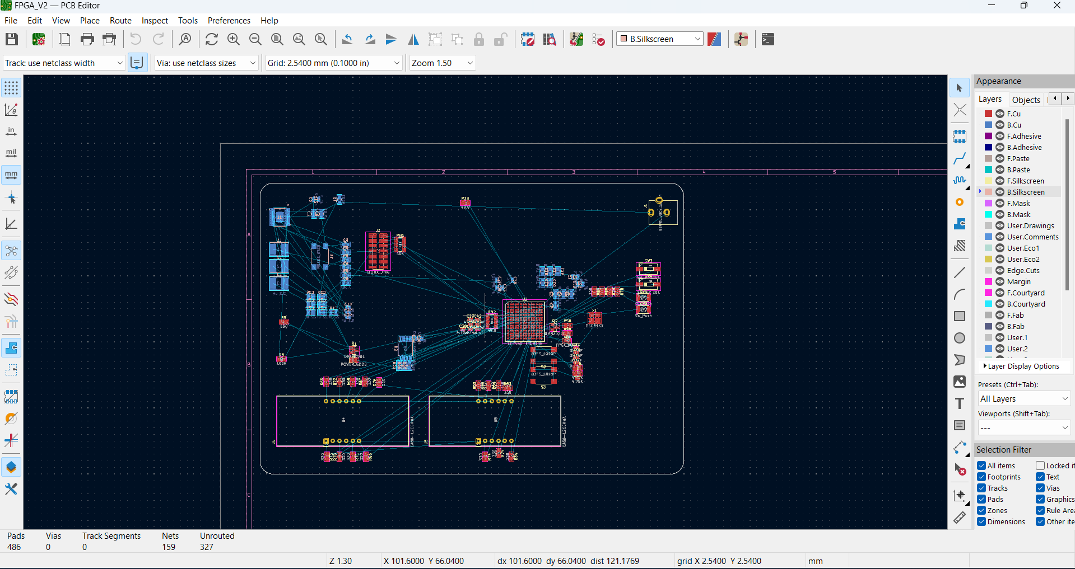
PCB Part
PCB-Layout

Slide 12
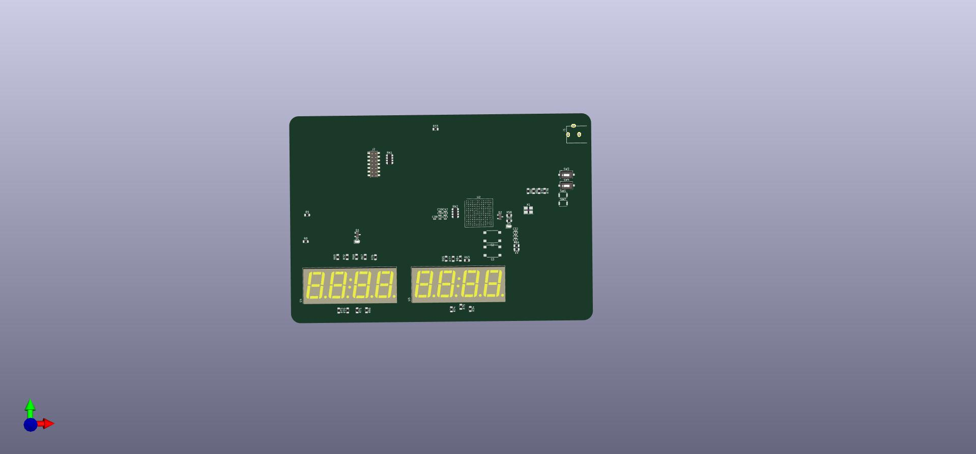
PCB Part
3D View

Slide 13
REAL Time Testing of the System

Slide 14
Thank you

